Slide 1

2022S AML 2304 Natural Language Processing Final Project
Instructor: Harriet Huang
Group Members:
Bhanu Prakash Mahadevuni C0850515
Deeksha Naikap C0835440
Pramod Reddy Gurrala C0850493
Sai Varun Kollipara C0828403

Slide 2
Problem Statement
The task is to perform Machine Learning models on a news dataset provided. The task includes to perform multiple word vectorization methods.
For the Solution proposed, we have considered 20 newsgroup data. We will be performing all the basic Data Analysis, Data Visualization, Machine Learning Model Building and Word Vectorization Methods.
We will compare the results from multiple models with the vectorization methods and try identifying the best model for the text-based applications.

Slide 3
Steps Involved
Importing Packages
EDA
Data Acquisition
Data Understanding
Data Visualization
Data Splitting
Word Vectorization
Count Vectorizer
TF-IDF Vectorizer
TSNE Visualizer
Model Building
Evaluation Function
Machine Learning Algorithms
Comparing the ML Algorithms with multiple Variables

Slide 4
Prerequisites
Dataset – 20 Newsgroup Data
Libraries – All the libraries for ML models, WV methods, basic analysis, data visualization, evaluation and others.
Word Vectorization Methods –
Count Vectorizer
TF-IDF Vectorizer
Machine Learning Models –
Logistic Regression
SVC
Naïve Bayes

Slide 5
About Dataset
This dataset consists of news about 20 different groups, each of the record has a header, footer, data, target, target_name and quote.
And the dataset can be called as full, train or test subsets.
Some functions are available for making it easy to work, like limiting the categories, removing some information about the record and compatible with ML models and functions.

Slide 6
EDA – Data Acquisition
We are collecting the data from the fetch_20newsgroups function.
We have created the variables according the subsets used.
We used the categories attribute to limit the usage of the categories.

Slide 7
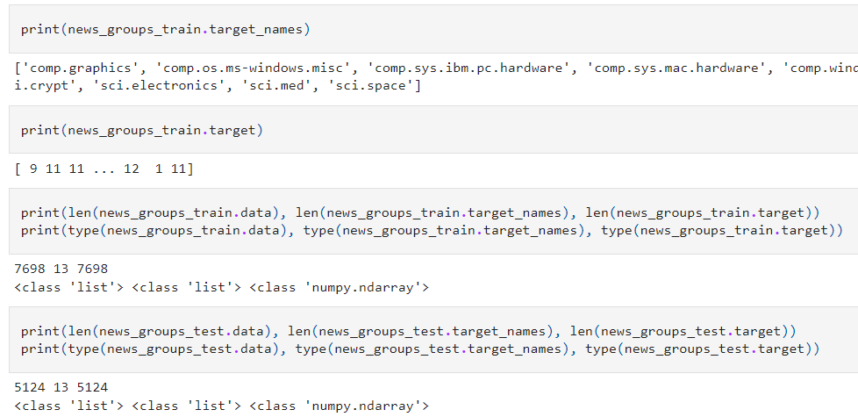
EDA – Data Understanding
After cleaning the data, we have our finalized data we need to perform the necessary data analysis.
In this step we are checking the details on the variables from test and train. Some of the details are listed below:
Target Name
Target
Length
Type of variable
Displaying the contents of variables
This step helps in identifying the features to be concentrated on.

Slide 8
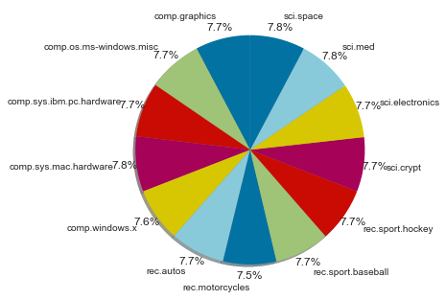
EDA – Data Visualization
Visualizing the data helps in identifying the relation between the variables. There are many types of visualizations we are looking at some.
In this figure here, we can see the pie chart of target name vs count.

Slide 9
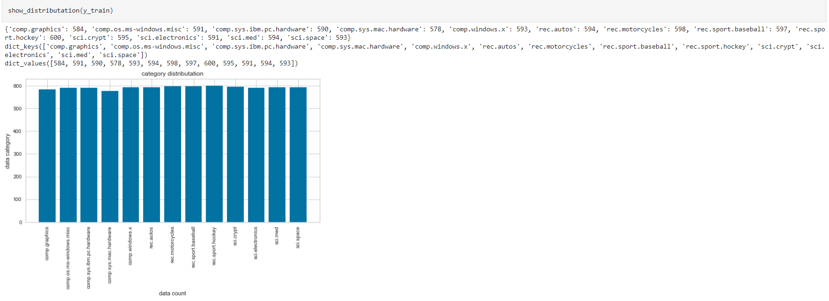
EDA – Data Visualization
We have also created a distribution function that performs the following tasks:
Sum of the count of target variables
Target list
Count list
Histogram of the variable

Slide 10
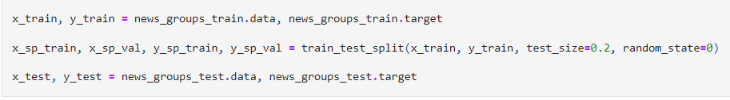
EDA – Data Splitting
As all the basic pre-processing steps are completed, now we will split the data into testing and training variables. Those will be used for the following:
Training the Model
Testing the Model
Validating the Model
Predicting the Model Performance
For TSNE Visualizing

Slide 11
Word Vectorization
A technique used in natural language processing (NLP) called word embeddings or word vectorization maps words or phrases from a lexicon to a corresponding vector of real numbers that can be used to identify word predictions and word similarity/semantics.
The term "vectorization" refers to a traditional technique for transforming input data from its original text-based format into real-number vectors, which is the format that is supported by ML models.
Some of the methods:
Count Vectorizer
Hashing Vectorizer
Word2Vec
Term frequency-inverse document frequency(TF-idf)
Pointwise mutual information (PMI)

Slide 12

Word Vectorization
There are many variables that are important for using vectorization functions. Some of them are listed here
max_df
min_df
stop_words

Slide 13
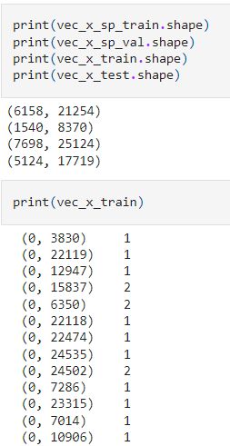
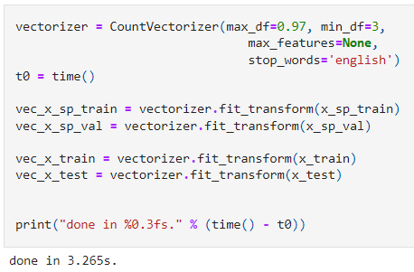
Count Vectorization
We have built a variable using count vectorizer function. This is used for creating test, train, validate variables that are used in TSNE visualizer and Model Training and Comparing the Model Performance.

Slide 14
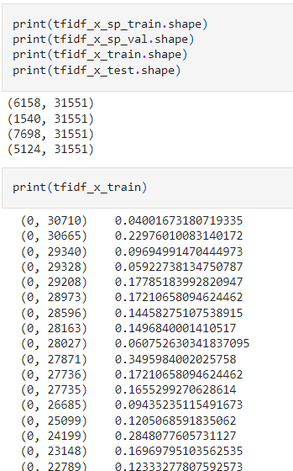
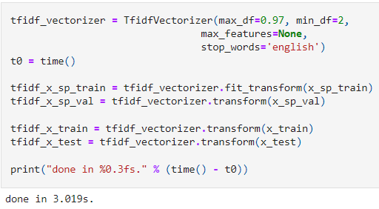
TF-IDF Vectorization
We have built a variable using Tf-IDF vectorizer function. This is used for creating test, train, validate variables that are used in TSNE visualizer and Model Training and Comparing the Model Performance.

Slide 15
TSNE
t-SNE which stands for t distribution-Stochastic neighborhood embedding
t-SNE is a Dimensionality Reduction algorithm
Generally, t-SNE is a technique to turn a list high-dimensional vectors into a list of lower dimensional ones while keeping the relative similarity of things as close to the original as possible.
It uses ML to try to create lower dimensional points, such that the pairs have a similar probability distribution across the pairs.

Slide 16
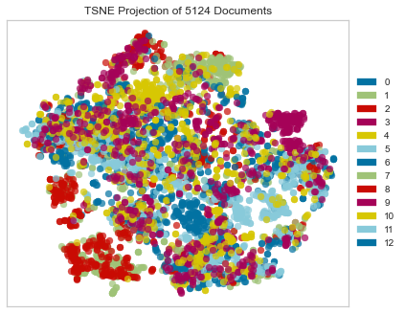
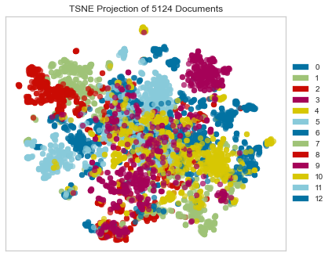
TSNE
Using Count Vectorizer Variables
Using TF-IDF Vectorizer Variables

Slide 17
Model Building
In this project, we are working on multiple machine learning models. Some of them are listed here:
SVC – Support Vector Classifier
Logistic Regression
Naïve Bayes

Slide 18
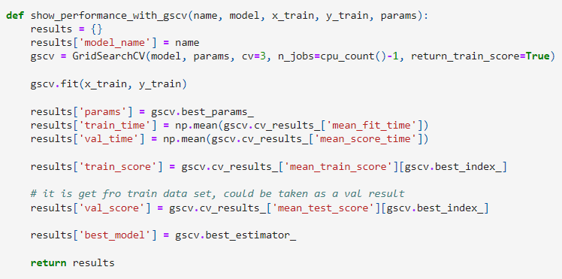
Model Building – Evaluation Function
After Building a Model we need some Metrics to classify the results.
We need them to compare the performance of any Machine Learning Model.
We are using time and score of the models in this function.

Slide 19
Model Building using TF-IDF Vectorization Variables

Slide 20
Model Building using Count Vectorization Variables

Slide 21
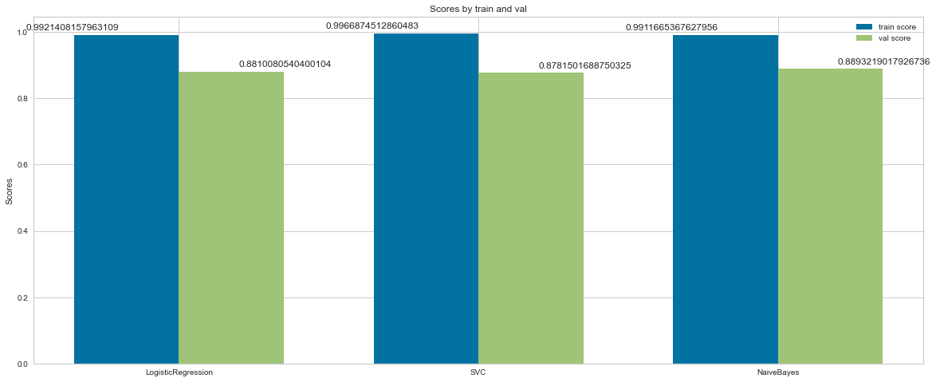
Model Comparison
ML Models with TF-IDF Vectorizer Variables.
Score for training and Validation.

Slide 22
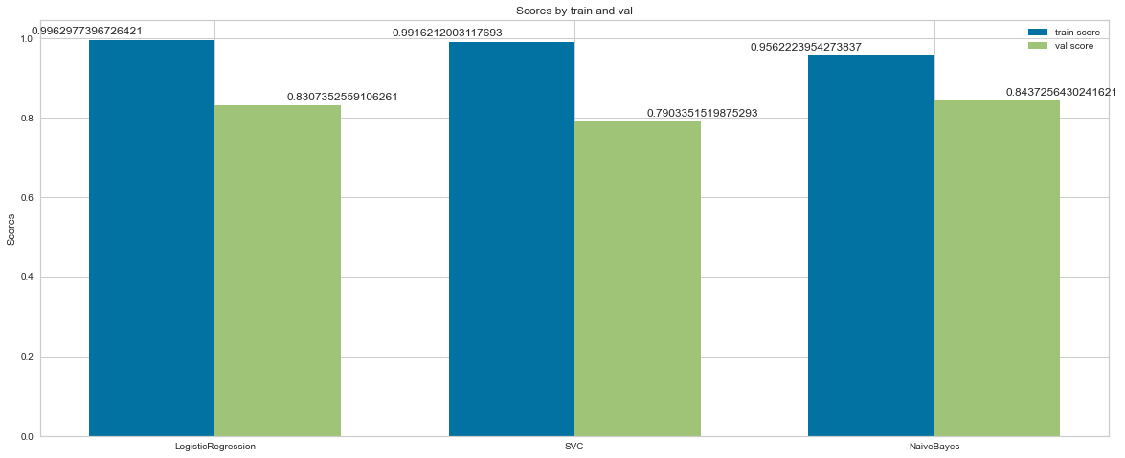
Model Comparison
ML Models with Count Vectorizer Variables.
Score for training and Validation.

Slide 23
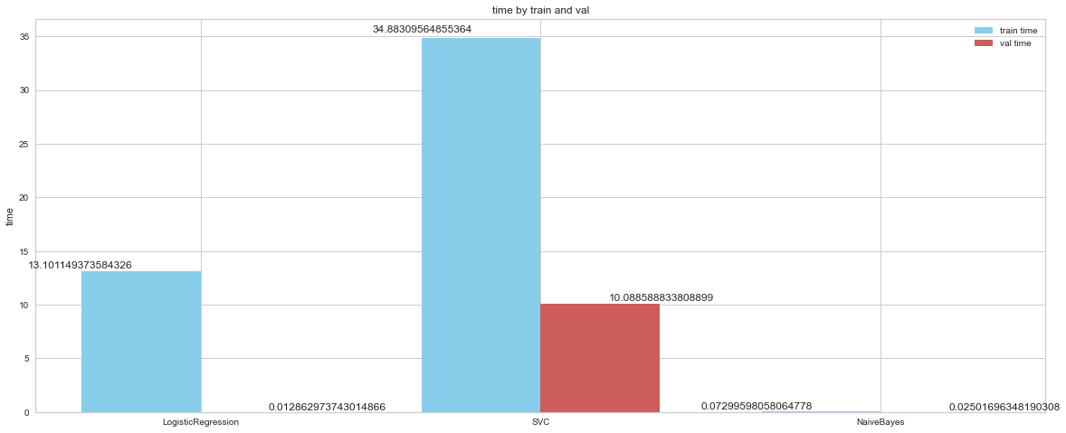
Model Comparison
ML Models with TF-IDF Vectorizer Variables.
Time for training and Validation

Slide 24
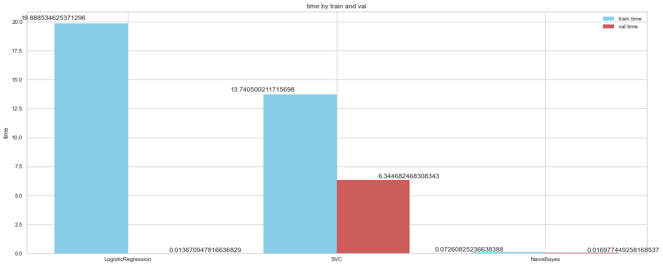
Model Comparison
ML Models with Count Vectorizer Variables.
Time for training and Validation

Slide 25
Conclusion
From the model building results, we can conclude that Naive Bayes Algorithm performs best for any type of Word Vectorization Methods.
We can also understand that TF-IDF data variables were able to provide more validation score than Count Vectorization variables.

Slide 26
References
https://scikit-learn.org/0.19/datasets/twenty_newsgroups.html
https://neptune.ai/blog/vectorization-techniques-in-nlp-guide
https://thepoints.medium.com/feature-extraction-from-text-using-countvectorizer-tfidfvectorizer-9f74f38f86cc
https://www.quora.com/What-is-the-difference-between-TfidfVectorizer-and-CountVectorizer-1
https://www.scikit-yb.org/en/latest/api/text/tsne.html
https://www.tutorialspoint.com/scikit_learn/index.htm
https://www.geeksforgeeks.org/learning-model-building-scikit-learn-python-machine-learning-library/
https://medium.com/@siyao_sui/nlp-with-the-20-newsgroups-dataset-ab35cd0ea902
https://www.researchgate.net/figure/A-text-snippet-from-the-20-Newsgroup-dataset-The-transparent-part-represents-the-local_fig1_339857996

Slide 27
Thank You

